Slide 1
Principles of
Parallel & Distributed Computing
Dr. Subrajeet Mohapatra
Assistant Professor
Department of Computer Science & Engineering,
BIT Mesra, Ranchi
Jharkhand

Slide 2
Introduction
Cloud computing is a new technological trend that supports better utilization of IT infrastructures, services, and applications.
Adopts a service delivery model based on a pay-per-use approach, in which users do not own infrastructure, platform, or applications but use them for the time they need them.
IT assets are owned and maintained by service providers who make them accessible through the Internet.
Parallel and distributed computing serve as foundations for building cloud computing systems and applications.

Slide 3
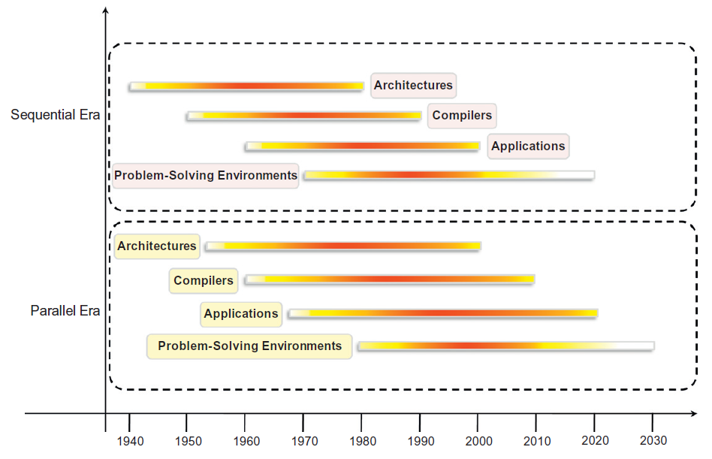
Eras of Computing

Slide 4
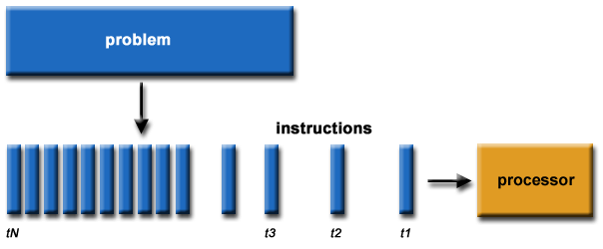
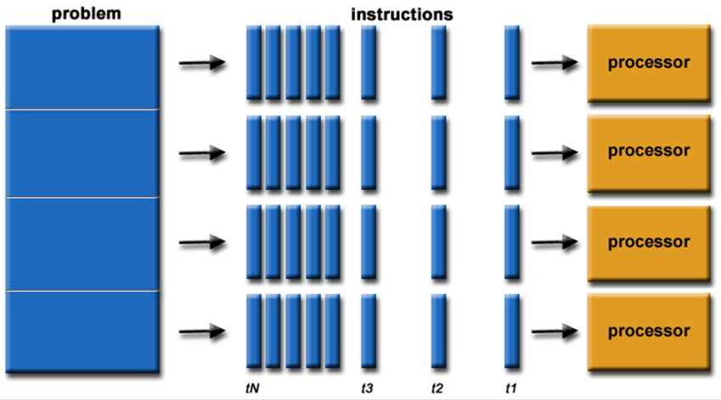
Serial vs. Parallel Computing
Serial Computing
Parallel Computing

Slide 5
Parallel & Distributed Computing
Parallel and Distributed computing are often used interchangeably even though they mean slightly different things.
They are based on systems concepts, such as concurrency, mutual exclusion, consistency in state/memory manipulation, message-passing, and shared-memory models.
The term parallel implies a tightly coupled system, whereas distributed refers to a wider class of system, including those that are tightly coupled.

Slide 6
Parallel Computing
Refers to a computing model in which the computation is divided among several processors sharing the same memory.
The architecture of a parallel computing system is often characterized by the homogeneity of components: each processor is of the same type and it has the same capability as the others.
Originally only those architectures were considered as parallel systems that featured multiple processors sharing the same physical memory (Considered as a single computer).
Over time, parallel systems now include all architectures that are based on the concept of shared memory, whether this is physically present or created with the support of libraries, specific hardware, and a highly efficient networking infrastructure.

Slide 7
Distributed Computing
Distributed computing (DC) encompasses any architecture or system that allows the computation to be broken down into units and executed concurrently.
The program execution can be on different computing elements, i.e. processors on different nodes, processors on the same computer, or cores within the same processor.
DC includes a wider range of systems and applications than parallel computing and is often considered a more general term.
Locations of the computing elements are usually not the same and such elements might be heterogeneous in terms of hardware and software features.
DC includes a wider range of systems and applications than parallel computing and is often considered a more general term.

Slide 8
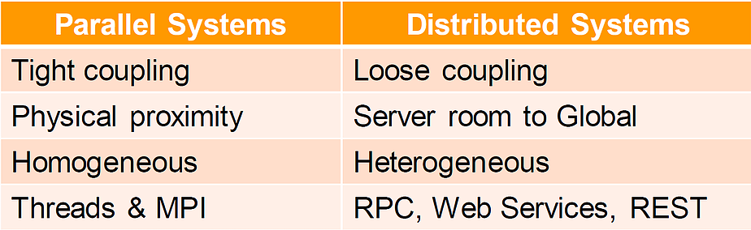
Parallel vs. Distributed Computing
Parallel Computing : All processors may have access to a shared memory to exchange information between processors.
Distributed computing : Each processor has its own private memory (distributed memory) and information is exchanged by passing messages between the processors.

Slide 9
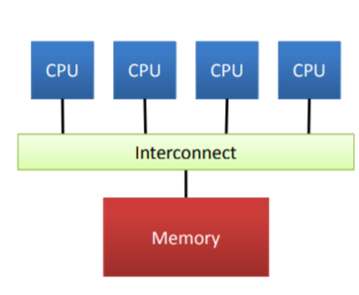
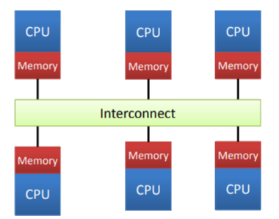
Shared vs. Distributed Memory
Shared Memory
Distributed Memory

Slide 10
Elements of Parallel Computing
Necessity of Parallel Computing
Computational requirements are ever increasing
Wastage of hardware resources in serial processing
Sequential architectures are reaching their physical limits
Processing speed is constrained by the speed of light
Density of transistors packaged in a processor is constrained by thermodynamic limitations.
Possible Solutions
Connecting multiple processors working in mutual coordination.
Developing techniques, architectures, and systems for performing multiple activities in parallel

Slide 11
What is Parallel Processing?
Processing of multiple tasks simultaneously on multiple processors is called parallel processing.
The parallel program consists of multiple active processes (tasks) simultaneously solving a given problem.
Each task is divided into multiple subtasks using a divide-and-conquer technique, and each subtask is processed on a different CPU.
Programming on a multiprocessor system using the divide-and-conquer technique is called parallel programming

Slide 12


Serial vs. Parallel Computing
Serial Computing
Parallel Computing

Slide 13
Serial vs. Parallel Computing
Serial Computing
Parallel Computing

Slide 14
H/W Architectures for Parallel Processing
Based on the number of instruction and data streams that can be processed simultaneously, computing systems are classified into the following four categories :
Single-instruction, single-data (SISD) systems
Single-instruction, multiple-data (SIMD) systems
Multiple-instruction, single-data (MISD) systems
Multiple-instruction, multiple-data (MIMD) systems

Slide 15
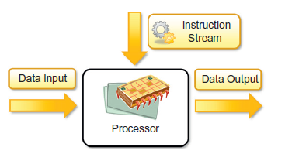
H/W Architectures for Parallel Processing
Single-instruction, single-data (SISD) systems
A uniprocessor machine capable of executing a single instruction, which operates on a single data stream.
Machine instructions are processed sequentially
Instructions and data to be processed have to be stored in primary memory

Slide 16
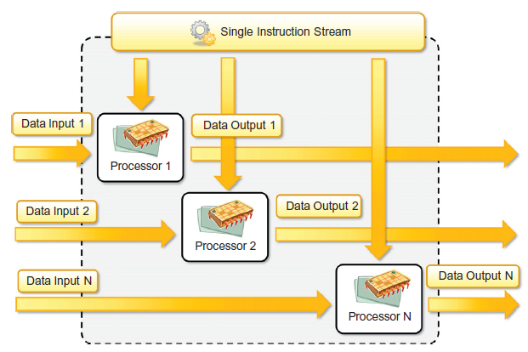
H/W Architectures for Parallel Processing
Single-instruction, multiple-data (SIMD) systems
A multiprocessor machine capable of executing the same instruction on all the CPUs but operating on different data streams.
SIMD based machines are well suited for scientific computing.

Slide 17
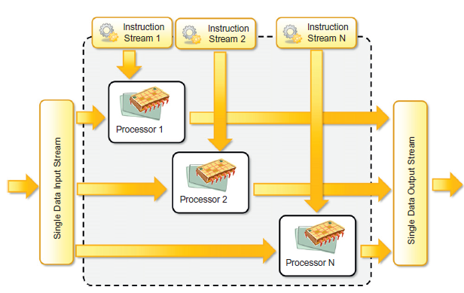
H/W Architectures for Parallel Processing
Multiple-instruction, single-data (MISD) systems
A multiprocessor machine capable of executing different instructions on different processing elements but all of them operating on the same data set

Slide 18
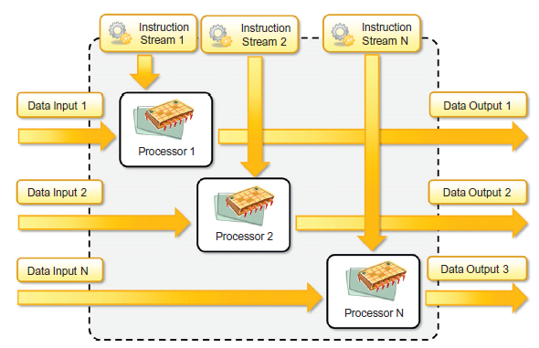
H/W Architectures for Parallel Processing
Multiple-instruction, Multiple-data (MIMD) systems
A multiprocessor machine capable of executing multiple instructions on multiple data set

Slide 19
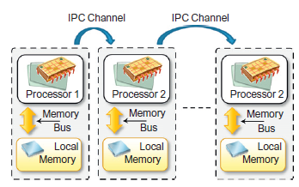
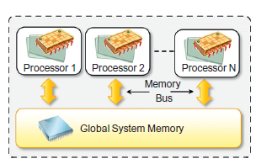
H/W Architectures for Parallel Processing
Classification of MIMD systems
A multiprocessor machine capable of executing multiple instructions on multiple data set
Processing elements in MIMD machines work asynchronously
MIMD machines are broadly categorized based on the way PEs are coupled to the main memory i.e. Shared-memory MIMD and Distributed-memory MIMD
Shared-memory MIMD
Distributed-memory MIMD

Slide 20
Approaches to Parallel Programming
Parallel Program :
The process of decomposing the program into smaller independent chunks of code is called a parallel program.
Parallel program facilitates working collectively of many processors.
Different Parallel Programming Approaches
Data Parallelism : Divide-and-conquer technique is used to split data into multiple sets, and each data set is processed on different PEs using the same instruction.
Process Parallelism : Operations with multiple (but distinct) activities can be processed on multiple processors.
Farmer-and-worker model : Based on job distribution approach (One processor is configured as master and all other remaining PEs are designated as slaves)

Slide 21
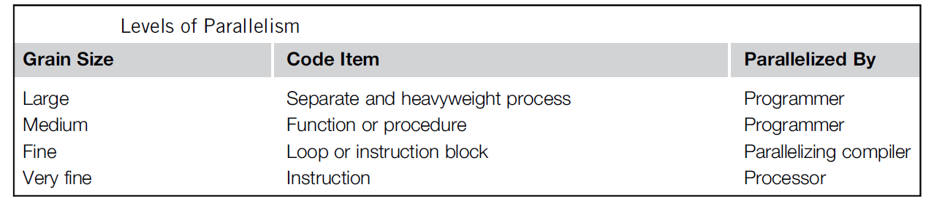
Levels of Parallelism
Parallelism within an application are based on the lumps of code (grain size) a potential candidate for parallelism.
Enables executing concurrently two or more single-threaded applications.
Intends to boost processor efficiency by hiding latency.

Slide 22
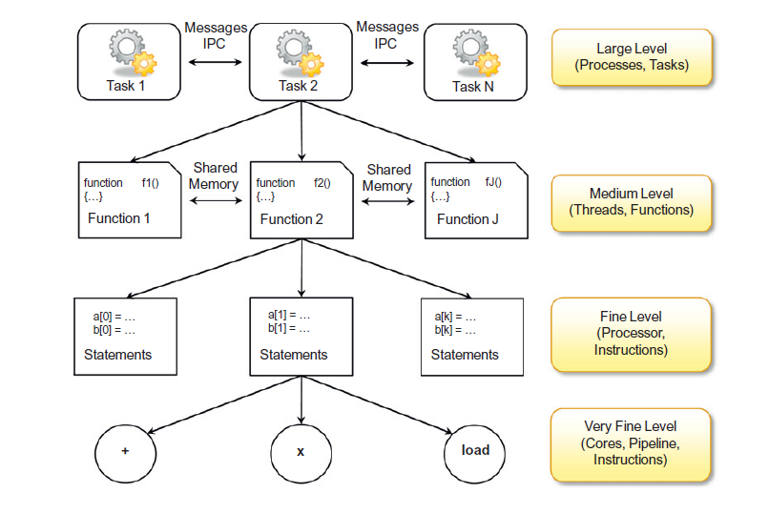
Levels of Parallelism

Slide 23
Elements of Distributed Computing
General concepts and definitions
Distributed computing studies the models, architectures, and algorithms used for building and managing distributed systems.
“A distributed system is a collection of independent computers that appears to its users as a single coherent system.”
“A distributed system is one in which components located at networked computers communicate and coordinate their actions only by passing messages.”
The components of a distributed system communicate with some sort of message passing.
Message passing encompasses several communication models.

Slide 24
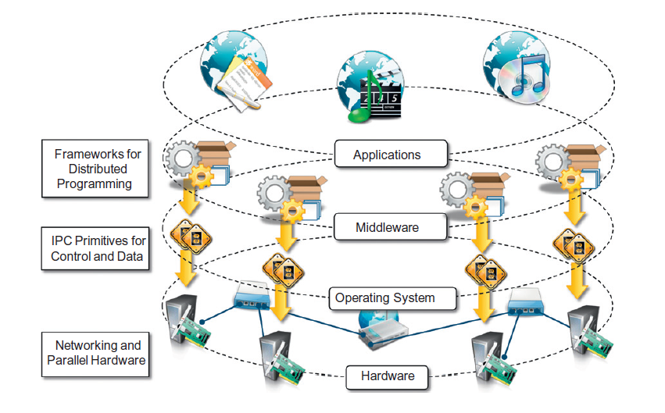
Components of a Distributed System
A distributed system is the result of the interaction of several components that traverse the entire computing stack from hardware to software.
A layered view of
Distributed System

Slide 25
Components of a Distributed System
Bottom Layer :
Physical Infrastructure
Operating System : IPC, Process Scheduling, File system management
Middleware Layer :
Leverages services to build a uniform environment for the development and deployment of distributed applications.
Supports programming paradigms for distributed systems
Provides a uniform interface to developers (independent from the underlying OS and hiding the heterogeneities of the bottom layers)
Application Layer :
Provides GUI’s designed and developed to use the middleware.

Slide 26
Components of a Distributed Computing
Bottom Layer :
Make up the physical infrastructure of one or more datacenters, where racks of servers are deployed and connected together through high-speed connectivity.
OS manages this infrastructure (machine and network management
Middleware Layer :
Core logic is implemented in the middleware
Provides a customizable runtime environment for applications
Application Layer :
Services are offered through Web 2.0-compliant interfaces.
Facilities catered ranges from virtual infrastructure building and deployment to application development and runtime environments.

Slide 27
Architectural Styles of Distributed Computing
“Architectural styles helps in understanding the interactions among different components (SW & HW) and their responsibilities in a distributed computing environment (across multiple machines.)”.
“Architectural styles are mainly used to determine the vocabulary of components and connectors that are used as instances of the style together with a set of constraints on how they can be combined”.
Architectural styles for distributed systems can be categorized into two major classes :
Software architectural styles --Logical organization of the software
System architectural styles-- Physical organization of distributed software

Slide 28
Architectural Styles of Distributed Computing
Components & Connectors
Component represents a unit of software that encapsulates a function or a feature of the system.
Examples of components can be programs, objects, processes, pipes, and filters.
Connector is a communication mechanism that allows cooperation and coordination among different components.
They are not encapsulated in a single entity and are implemented in a distributed manner over many system components.

Slide 29
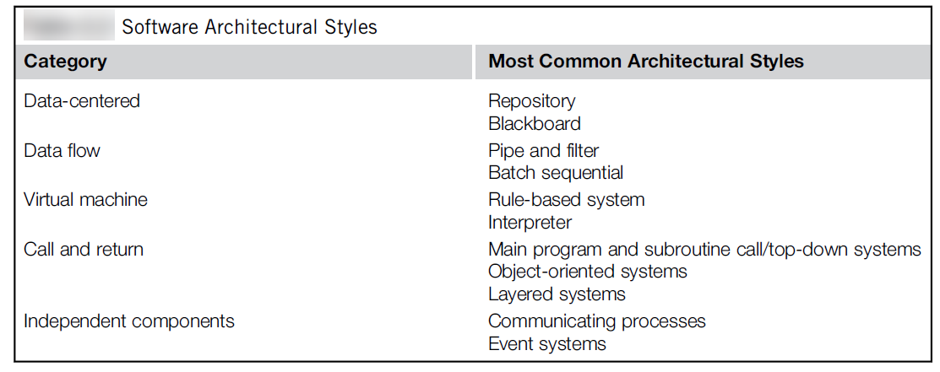
Software Architectural Styles
Software architectural styles are based on the logical arrangement of software components.
Provide an intuitive view of the whole system, despite its physical deployment.

Slide 30
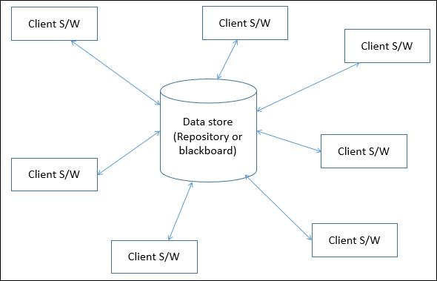
Software Architectural Styles
Data Centered Architecture :
Data is centralized and accessed frequently by other components, which modify data.
Achieving integrality of data is most important
Different components communicate through shared data repositories
Example: Database architecture and Web architecture
Types of Components
A central data structure or data store
A data accessor or collection of different components operate on the central data store and perform computations, and put back the results.

Slide 31
Software Architectural Styles
Data Centered Architecture :
Communication between the data accessors is only through the data store.
The data is the only means of communication among clients.
Flow of control differentiates the architecture into two categories :-
Repository architecture Style : The data store is passive and the clients (software components or agents) are active, which control the flow logic.
Blackboard architecture Style : The data store is active and the clients are passive, and the logical flow is determined by the current data status of the data store.

Slide 32
Software Architectural Styles
Data Flow Architecture
The whole software system is viewed as a series of transformations on consecutive pieces of input data, where data and operations are independent of each other.
Data enters into the system and then flows through the modules one at a time until they are assigned to some final destination (output or a data store).
Connections between the components may be implemented as I/O stream, I/O buffers, piped, or other types of connections.
Suitable for applications involving a well-defined series of independent data transformations (computations) on orderly defined input and output.

Slide 33
Software Architectural Styles
Data Flow Architecture
Data Flow Architecture approaches can be classified based on execution of sequences between modules
Batch Sequential
Pipe and Filter
Process Control

Slide 34
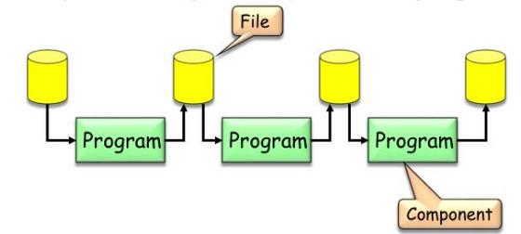
Software Architectural Styles
Batch Sequential :
A sequential data processing model
Separate programs are executed in order and the data is passed as an aggregate from one program to the next.
Provides simpler divisions on subsystems and each can be an independent program working on input data and produces output data.
Features
Components are independent programs
Connectors are media (typically files)
Each step runs to completion before next step begins
Disadvantages
Provides high latency and low throughput.
Does not provide concurrency and interactive interface.

Slide 35
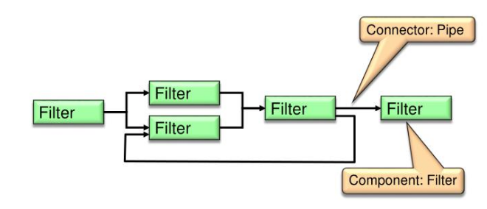
Software Architectural Styles
Pipe and Filter:
A variation of the batch sequential style for expressing the activity of a software system as sequence of data transformations.
Filter is an independent entity which perform transformation on data and process the input they receive.
Pipes serve as connectors for the stream of data being transformed, each connected to the next component in the pipeline.
Features
Ensures loose and flexible coupling of components, filters
Supports parallel processing
Each filter can be called and used over and over again
Disadvantages
Reduced performance due to excessive computational overheads.
Unsuitable for an interactive system
May not be appropriate for long-running computations.

Slide 36
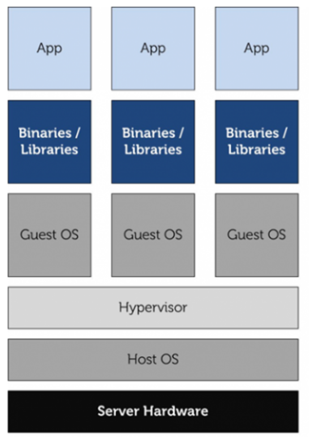
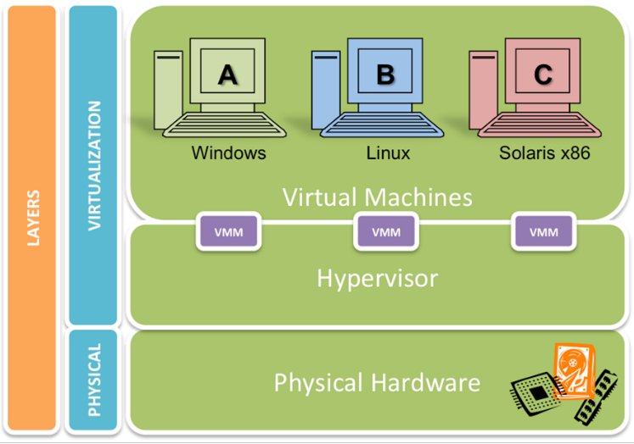
Software Architectural Styles
Virtual Machine Architectures
Characterized by the presence of an abstract execution environment (VM)
Simulates features that are not available in the H/W or S/W
Applications are implemented on top of this virtualization layer

Slide 37
System Architectural Styles
Deals with physical organization of components and processes over a distributed infrastructure
Provide a set of reference models for the deployment of distributed systems
Fundamental reference styles
Client/server
Peer-to-Peer.

Slide 38
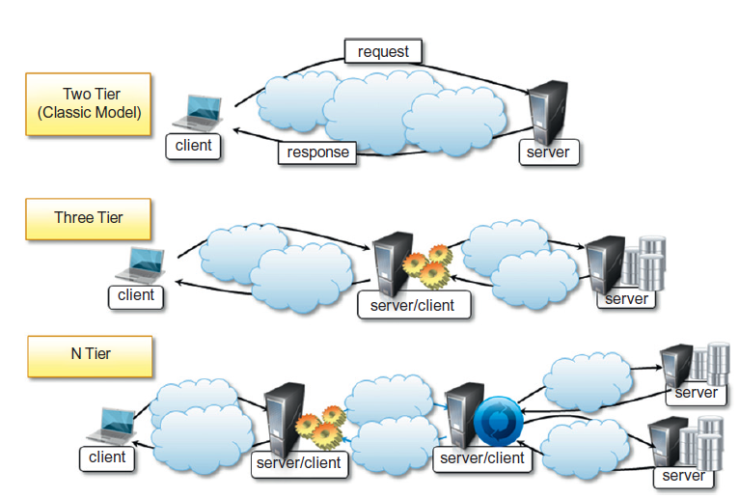
System Architectural Styles
Client/Server
Client/Server model features a server and a client.
Interaction is through a network connection using a given protocol
Major Models
Thin-client model
Fat-client model

Slide 39
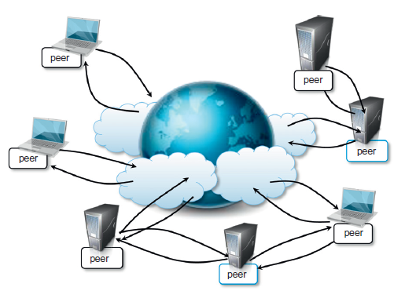
System Architectural Styles
Peer-to-Peer (P2P)
A symmetric architecture which allows H/W and S/W to communicate without the need for a server
Each peer acts as a server when it processes requests from other peers and as a client when it issues requests to other peers

Slide 40
Inter Process Communication
Process is the instance of a computer program that is being executed.
A process can be classified as
Independent process--Not affected by the execution of other processes
Co--operating process--Affected by other executing processes
Inter process communication (IPC) is a mechanism which allows processes to communicate with each other and synchronize their actions.
IPC is a method of co--operation between the processes for problem solving.
Processes can communicate with each other through
Shared Memory
Message Passing
Remote Procedure Call (RPC)

Slide 41
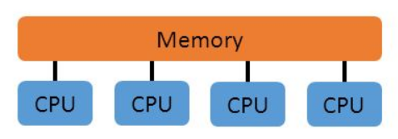
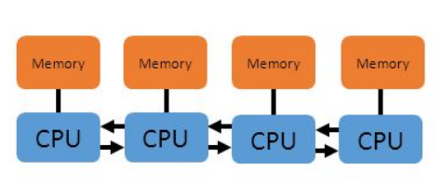
Inter Process Communication
Shared Memory vs. Message Passing
Shared Memory
Implicit communication via memory operations (load/store/lock)
Global address space
Message Passing
Communicate data among a set of processors without the need for a global memory
Each process has its own local memory and communicate with others using message passing

Slide 42
Inter Process Communication
Remote Procedure Call (RPC)
Protocol for constructing distributed client-server based applications
An abstraction of inter--process communication
RPC runtime takes care of the network differences between the processes
Called procedure need not exist in the same address space as the calling procedure
Processes may be on the same system, or they may be on different systems with a network connecting them

Slide 43
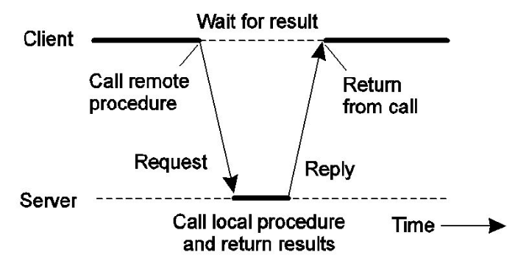
Inter Process Communication
Basic Remote Procedure Call Operation
Process communication between caller & callee can be hidden using procedure call mechanism

Slide 44
Message based Communication in IPC
Message-based communication model refers to various model for inter-process communication, which is based on the data streaming abstraction
Major distributed programming models that uses “message-based communication model”
Message Passing
Remote Procedure Call
Distributed Objects
Active Objects
Web Services

Slide 45
Message based Communication in IPC
Message Passing
The concept of message is the main abstraction of the model
Entities exchanging data and information explicitly encode in the form of message
Remote Procedure Call
Explores the possibilities of remote procedural call (execution of program in remote processes)
Distributed Objects
Implementation of RPC model for the Object-oriented model
Contextualizes remote invocation of methods extended by objects
Active Objects
The Active object pattern's goal is to separate the method calling from method execution.

Slide 46
Message based Communication in IPC
Web Services
Provides an implementation of the RPC concept over HTTP
Allows interaction of components developed with different technologies
Summary:
Message is a fundamental abstraction of IPC, and is used either explicitly or implicitly
Principal use of message passing is to define interaction protocols among distributed components for coordinating data exchange activity

Slide 47
Message based Communication Models
Constitutes a fundamental block for several distributed programming paradigms
Important to understand how messages are exchanged and among how many distributed components
Client server model has been identified as reference model for interaction in most cases
Variations of the client server model allow for different interaction patterns
Point-to-point message model
Publish-and-subscribe message mode
Request-reply message model

Slide 48
Technologies for Distributed Computing
Relevant technologies that provide concrete implementations of interaction models which mostly rely on message-based communication
Remote Procedure Call
Distributed Object Framework
Examples of Distributed Object Framework
Common Object Request Broker Architecture (CORBA)
Distributed component object model(DCOM/COM1)
Java Remote Method Invocation (RMI)
.NET remoting

Slide 49
Service Oriented Computing
Organizes distributed systems in terms of services representing major abstraction for building systems
Service orientation expresses applications and software systems as aggregations of services that are coordinated within a service-oriented architecture(SOA)
Web services are the de facto approach for developing SOA
Web services enables cloud computing systems leverage the Internet as the main interaction channel between users and the system

Slide 50
Service Oriented Computing
What is a service?
A service encapsulates a software component that provides a set of coherent and related functionalities that can be reused and integrated into bigger and more complex applications
Major characteristics that identify a service
Boundaries are explicit--Application composed of services that are spread across different domains, trust authorities, and execution environments
Services are autonomous--Not designed to be part of a specific system, but can be integrated in several S/W systems at the same time
Services share schema and contracts, not class or interface definitions
Not expressed in terms of classes or interfaces
Define themselves in terms of schemas and contracts
Services compatibility is determined based on policy--Service orientation separates structural compatibility from semantic compatibility

Slide 51
Service Oriented Architecture (SOA)
SOA organizes a software system into a collection of interacting services
Encompasses a set of design principles for facilitating system development
Provides a means for integrating components into a coherent and decentralized system
Service provider and service consumer are two major roles within SOA

Slide 52
Service Oriented Architecture (SOA)
A reference model for architecting several software systems, especially enterprise business applications and other systems
Guiding principles which characterize SOA platforms
Standardized Service Contract
Loose Coupling
Abstraction
Reusability
Autonomy
Lack of State
Discoverability
Composability

Slide 53
Web Services
Prominent technology for implementing SOA systems and applications
Leverage internet technologies and standards for building distributed systems
Allow interoperability across different platforms and programming languages
Characteristics that makes web services the technology of choice for SOA
Allow for interoperability across different platforms and programming languages
Based on well-known and vendor-independent standards such as HTTP, SOAP, XML, and WSDL
Provide an intuitive and simple way to connect heterogeneous software systems
Provide features required by enterprise business applications to be used in an industrial environment

Slide 54
Thank You
10

